Slide 1
XGBoost and LGBM

Slide 2
XGBoost algorithm was developed as a research project at the University of Washington. Tianqi Chen and Carlos Guestrin presented their paper at a Conference in 2016 and caught the Machine Learning world by fire.
XGBoost and Gradient Boosting Machines (GBMs) are both ensemble tree methods that apply the principle of boosting weak learners (CARTs generally) using the gradient descent architecture. However, XGBoost improves upon the base GBM framework through systems optimization and algorithmic enhancements.

Slide 3
A model in supervised learning usually refers to the mathematical structure of by which the prediction Yi is made from the input xi.
A common example is a linear model, where the prediction is given as 𝑦̂ 𝑖=∑𝑗𝜃𝑗𝑥𝑖𝑗,
a linear combination of weighted input features
The parameters are the undetermined part that we need to learn from data. In linear regression problems, the parameters are the coefficients 𝜃. Usually we will use 𝜃 to denote the parameters
𝜃 will be identified by minimizing the loss which is an objective function.

Slide 4


Objective Function : Training Loss + Regularization
We need to find a way to find the best parameters given the training data. In order to do so, we need to define objective function, to measure the performance of the model given a certain set of parameters.
A very important fact about objective functions is they must always contain two parts: training loss and regularization
where L is the training loss function, and Ω is the regularization term. The training loss measures how predictive our model is on training data.
For example, a commonly used training loss is mean squared error

Slide 5
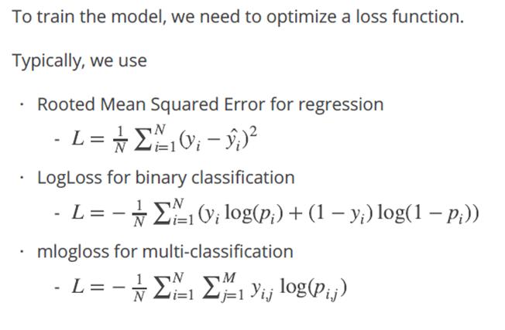
Training Objective

Slide 6
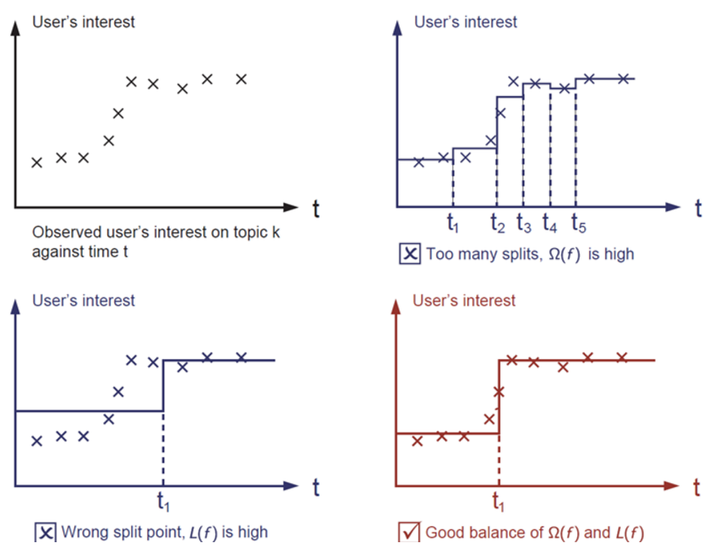
The regularization term is what people usually forget to add. The regularization term controls the complexity of the model, which helps us to avoid overfitting.
Let us consider the following problem in the following picture. You are asked to fit visually a step function given the input data points on the upper left corner of the image. Which solution among the three do you think is the best fit?

Slide 7
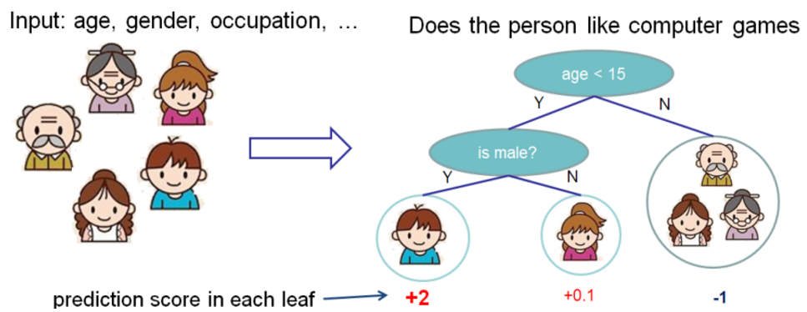
XGBOOST : CART tree
Model xgboost: tree ensembles. The tree ensemble model is a set of classification and regression trees (CART).
Here’s a simple example of a CART that classifies whether someone will like computer games
We classify the members of a family into different leaves and assign them the score on the corresponding leaf.
The leaf only contains decision values.
In CART, a real score is associated with each of the leaves, which gives us richer interpretations that go beyond classification.
Usually, a single tree is not strong enough to be used in practice.

Slide 8

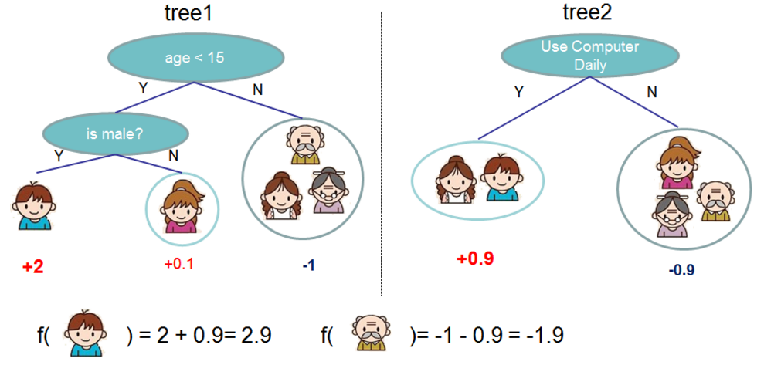

Here is an example of a tree ensemble of two trees. The prediction scores of each individual tree are summed up to get the final score. If you look at the example, an important fact is that the two trees try to complement each other. Mathematically, we can write our model in the form
Where K is the number of trees,
f is a function in the functional space F, and F is the set of all possible CARTs.
The objective function to be optimized is given by

Slide 9

Tree Boosting
How should we learn the trees? The answer is, as is always for all supervised learning models: define an objective function and optimize it!
Assume we have the following objective function (remember it always needs to contain training loss and regularization)

Slide 10
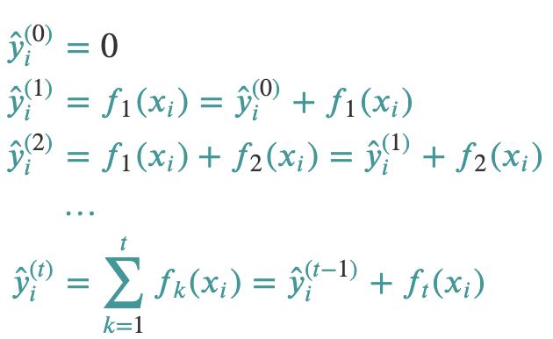
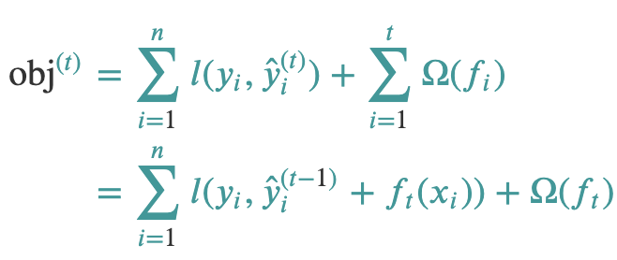
Additive Training
Use an additive strategy: fix what we have learned and add one new tree at a time.
We write the prediction value at step 𝑡 as 𝑦̂ (𝑡)𝑖.
Then we have
which tree do we want at each step? A natural thing is to add the one that optimizes our objective.

Slide 11
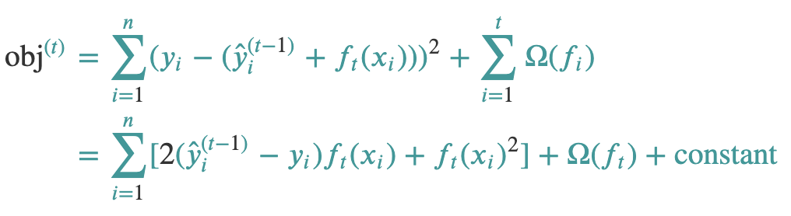
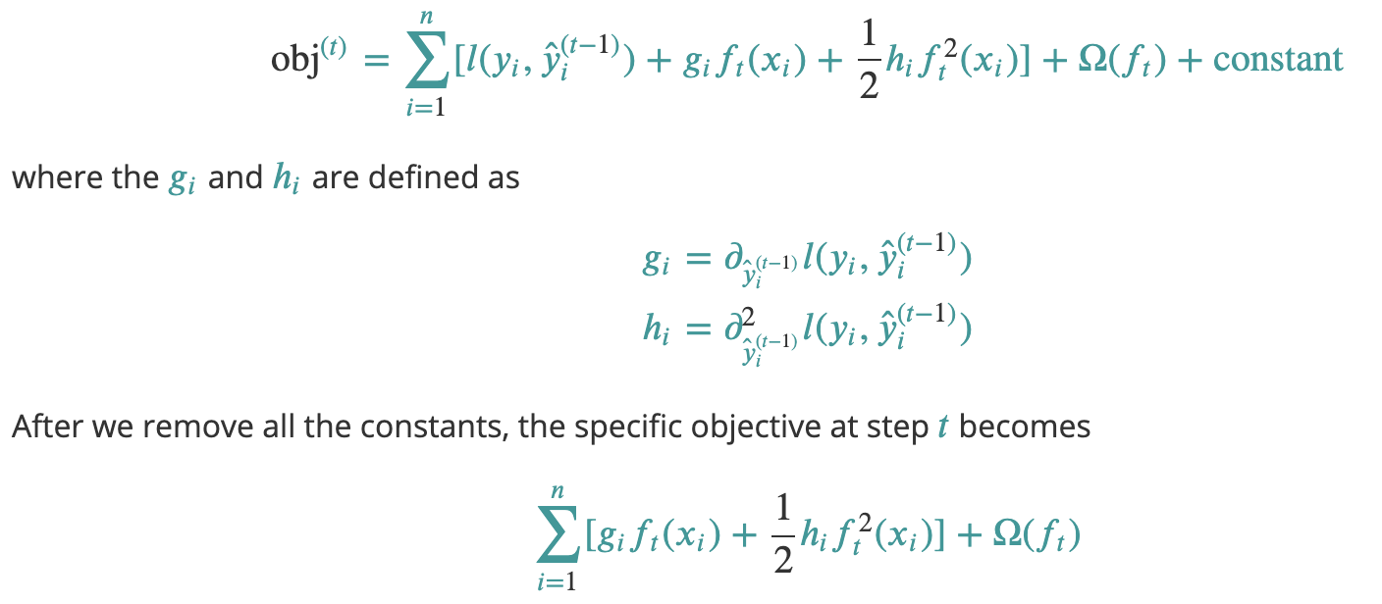
If we consider using mean squared error (MSE) as our loss function, the objective becomes
Function approximation : Taylor expansion of the loss function up to the second order:

Slide 12

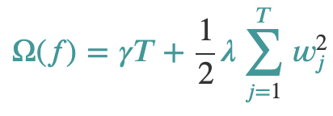
Model Complexity : Regularization term
Let us refine the definition of the tree 𝑓(𝑥) as
Here 𝑤 is the vector of scores on leaves, 𝑞 is a function assigning each data point to the corresponding leaf, and 𝑇 is the number of leaves. In XGBoost, we define the complexity as

Slide 13
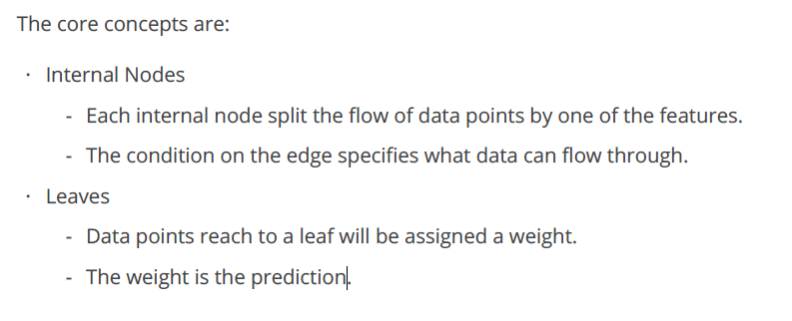
Tree Building methodology

Slide 14
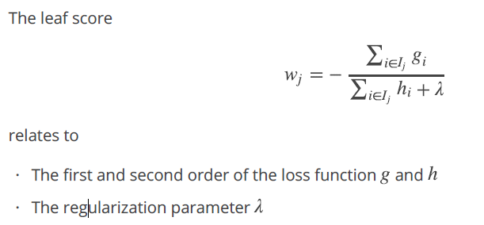

Slide 15
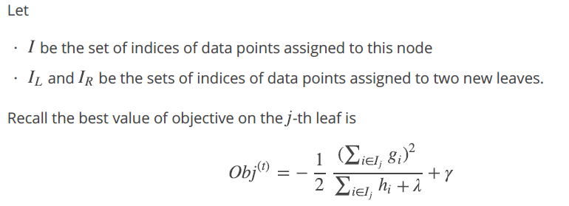
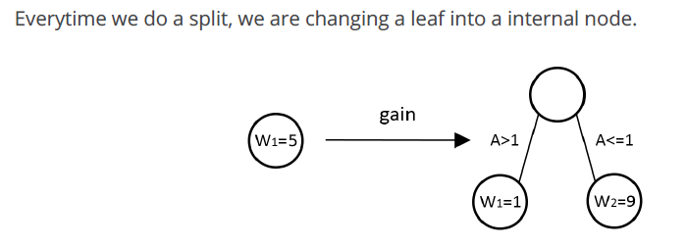
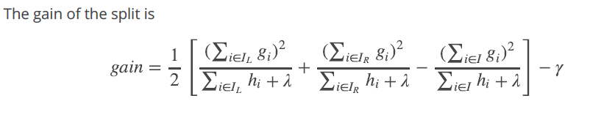
Definition to "the best split" by the objective

Slide 16
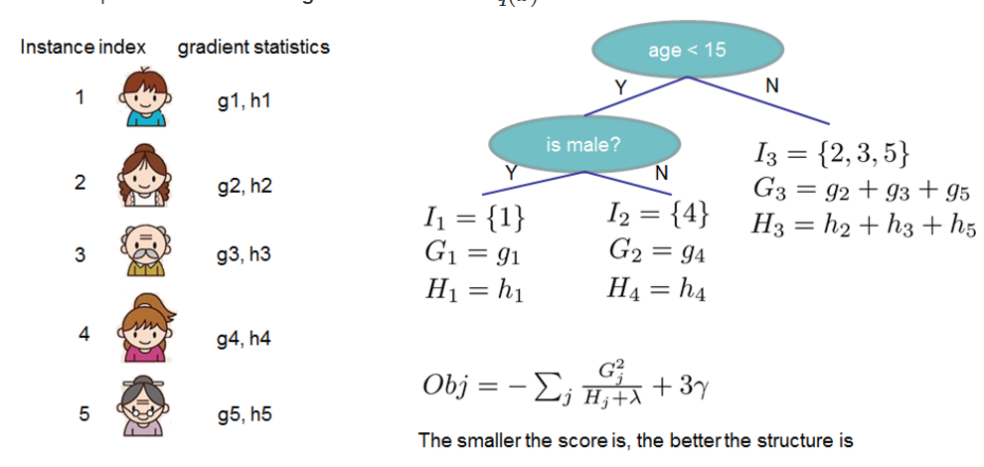
let’s look at the picture and see how the scores can be calculated. Basically, for a given tree structure, we push the statistics gi and hi to the leaves they belong to, sum the statistics together, and use the formula to calculate how good the tree is. This score is like the impurity measure in a decision tree, except that it also takes the model complexity into account.

Slide 17
System Optimization:
Parallelization: XGBoost approaches the process of sequential tree building using parallelized implementation.
Tree Pruning: The stopping criterion for tree splitting within GBM framework is greedy in nature and depends on the negative loss criterion at the point of split. XGBoost uses ‘max_depth’ parameter as specified instead of criterion first, and starts pruning trees backward. This ‘depth-first’ approach improves computational performance significantly.
lgorithmic Enhancements:
Regularization: It penalizes more complex models through both LASSO (L1) and Ridge (L2) regularization to prevent overfitting.
Sparsity Awareness: XGBoost naturally admits sparse features for inputs by automatically ‘learning’ best missing value depending on training loss and handles different types of sparsity patterns in the data more efficiently.
Cross-validation: The algorithm comes with built-in cross-validation method at each iteration, taking away the need to explicitly program this search and to specify the exact number of boosting iterations required in a single run.

Slide 18
LGBM

Slide 19
Light GBM uses a novel technique of Gradient-based One-Side Sampling (GOSS) to filter out the data instances for finding a split value
In AdaBoost, the sample weight serves as a good indicator for the importance of samples.
However, in Gradient Boosting Decision Tree (GBDT), there are no native sample weights,
and thus the sampling methods proposed for AdaBoost cannot be directly applied.
Here comes gradient-based sampling

Slide 20
Gradient represents the slope of the tangent of the loss function, so the idea is, if gradient of data points are large in some sense, these points are important for finding the optimal split point as they have higher error.
GOSS keeps track of all the instances with large gradients and performs random sampling on the instances with small gradients.
For example, let’s say I have 500K rows of data where 10k rows have higher gradients. So the algorithm will choose (10k rows of higher gradient+ x% of remaining 490k rows chosen randomly).
Let’s say x is 10%, total rows selected are 59k out of 500K based on which split value if found

Slide 21
This is a method that is employed exclusively in lightGBM. The essential observation behind this method is that not all data points contribute equally to training; data points with small gradients tend to be more well trained (close to a local minima). This means that it is more efficient to concentrate on data points with larger gradients
The most straightforward way to use this observation is to simply ignore data points with small gradients when computing the best split. However, this has the risk of leading to biased sampling, changing the distribution of data. For instance, if data that belonged to the "young" age group tended to be less well trained, the sampled data will have a much younger age distribution. This means that the split is likely to be younger than the optimal value

Slide 22
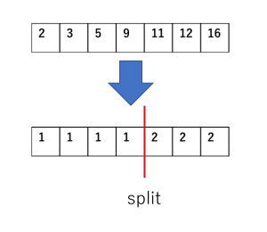
Finding the Best Split:
This step requires the algorithm to go through every feature of every data point. The computational complexity is
O(nxn)
For instance, a tf-idf matrix of a million documents with a vocabulary size of 1 million would have a trillion entries.
Thus, a naive GBDT would take forever to train on such datasets
Histogram-based methods:
Firstly the number of bins creates a trade-off between speed and accuracy:
the more bins there are, the more accurate the algorithm is, but the slower it is as well.
Ignoring sparse inputs:
lightGBM internal table data tend to be sparse. Since the vast majority of the values will be 0. These zeroes will be ignored.
This reduces the number of samples that have to be used when evaluating each split, speeding up the training process.

Slide 23
Exclusive Feature Bundling
The essential observation behind this method is that the sparsity of features means that
some features are never non-zero together.
For instance, the words "Python" and "protein" might never appear in the same document in the data.
This means that these features can be "bundled" into a single feature without losing any information.
Suppose the tf-idf score for "Python" ranges from 0 to 10 and the tf-idf score for "protein" ranges from 0 to 20.
In this case, the feature

Slide 24
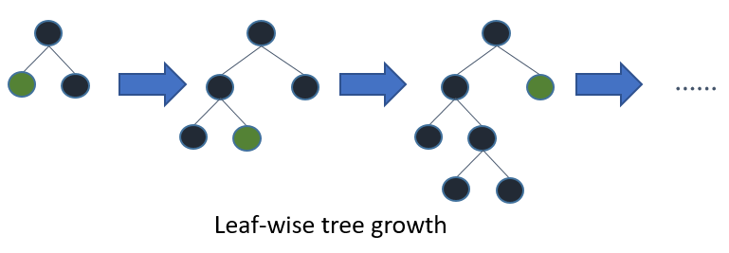
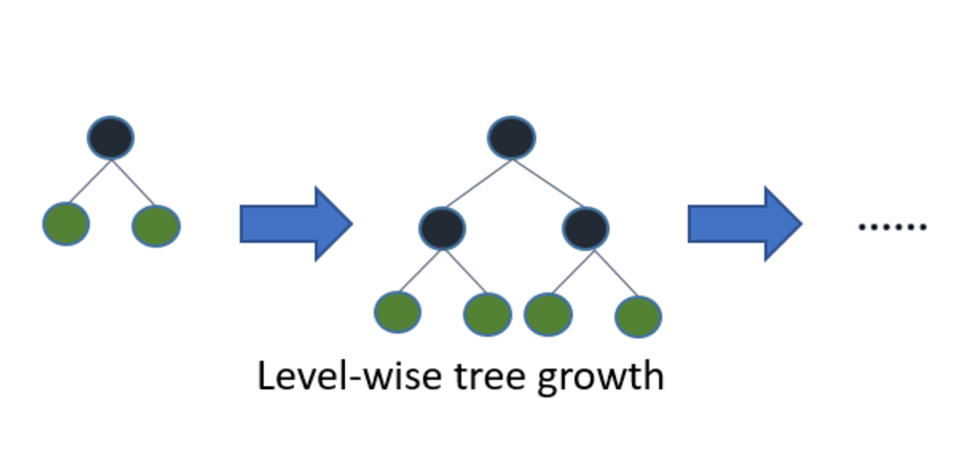
Light GBM grows tree vertically while other algorithm grows trees horizontally meaning that Light GBM grows tree leaf-wise while other algorithm grows level-wise. It will choose the leaf with max delta loss to grow. When growing the same leaf, Leaf-wise algorithm can reduce more loss than a level-wise algorithm

Slide 25
Thank you

